Slide 1
Azure Infrastructure-as-a-service Masterclass
 MSIaaS1011
Microsoft Azure
William Eastbury
Technical Evangelist – DX
 William.Eastbury@Microsoft.com
 /in/willeastbury
 @WillEastbury
Notes:
We will talk about
Azure Resource Manager,
Desired State Configuration,
Virtual Networking,
Storage Performance
and VM Scale Sets

Slide 2

The theme for the afternoon
IaaS
Microsoft Azure
“Life is really simple, but we insist on making it complicated.”
Confucius
@WillEastbury

Slide 3
But First… Please fill out your Evaluation Forms !
 MSIaaS1011

Slide 4
Azure Resource Manager Deploying infrastructure
Notes:
The infrastructure for your application is typically made up of many components – maybe a virtual machine, storage account, and virtual network, or a web app, database, database server, and 3rd party services.
You do not see these components as separate entities, instead you see them as related and interdependent parts of a single entity. You want to deploy, manage, and monitor them as a group.
DevOps Deployment Automation - Requires a faster, more flexible deployment approach than the old ASM gateway and powershell could provide – ASM PowerShell can be very complex to define and troubleshoot.

Slide 5
“Life is already really complicated, so we insist on making it even more complicated.”
Azure Service Management APIs Design Team
@WillEastbury
Notes:
The theme for the afternoon will be.

Slide 6
“Life is already far too complicated, so lets try and make it simpler.”
Azure Resource Manager Design Team
@WillEastbury
Notes:
The theme for the afternoon will be.

Slide 7
“Life is already far too complicated, so lets try and express everything in JSON format.”
Azure Resource Manager Implementation Team
@WillEastbury
Notes:
The theme for the afternoon will be.

Slide 8
How I want the world to look… {World}
Azure Resource Manager Implementation Team
Notes:
The theme for the afternoon will be.

Slide 9
How they see the world… {[Resource]}
Azure Resource Manager Implementation Team
Notes:
The theme for the afternoon will be.

Slide 10
Azure Service Management vs Azure Resource Manager
{World}
ASM – Imperative infrastructure deployment
"Dear Azure, here's a list of everything I want you do, in excruciating detail“
ARM - Declarative desired-state deployment
"Dear Azure, here's what I want it to look like - go, make it happen"
Notes:
ARM does desired-state deployment of resources. It does not do desired-state configuration inside these resources (e.g., VMs), although it can initiate the process of desired-state configuration.
ONE API to deploy EVERYTHING
Faster Deployments – ARM can deploy in true parallel as compared to semi-sequential in ASM
RBAC is fully integrated with AAD – and is a long-requested feature.
Resource-provider model is intended to be fully extensible.
Common interface for Azure and Azure Stack – When Azure Stack is released, same API model for on-premises and Cloud

Slide 11
“Now life is simple to deploy resources. BUT the content of those resources are already far too complicated, so lets try and express everything declaratively in PowerShell.”
PowerShell Desired State Configuration
Implementation Team
@WillEastbury
Notes:
The theme for the afternoon will be.

Slide 12
Automating Deployment with PowerShell DSC Deploying ‘cattle’, not ‘pet’ servers.
Notes:
Speak to speed of service development in IaaS as well.
Speak about cattle and pets – as we move to the cloud, we need to deploy ‘disposable servers’
Show the DSC pull Server
…

Slide 13
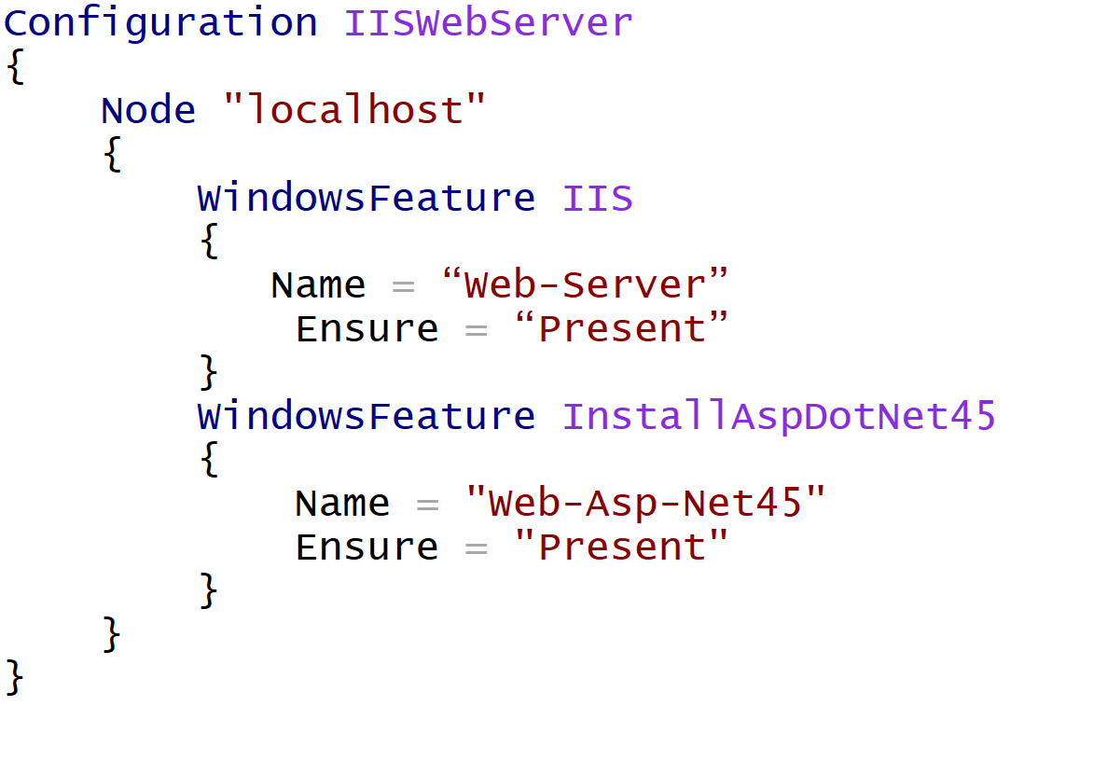
PowerShell DSC Script – Install IIS and ASP.Net
@WillEastbury
Notes:
Then open portal and demo

Slide 14
DEMO 1: PowerShell DSC Deployment

Slide 15
“Now life is simple to deploy and build resources. But connecting them together and securing them is far too complicated, so lets talk Virtual Networks.”
Azure Virtual Networking
Implementation Team
@WillEastbury
Notes:
The theme for the afternoon will be.

Slide 16
Networking Choices Connecting your machines and virtual networks together

Slide 17
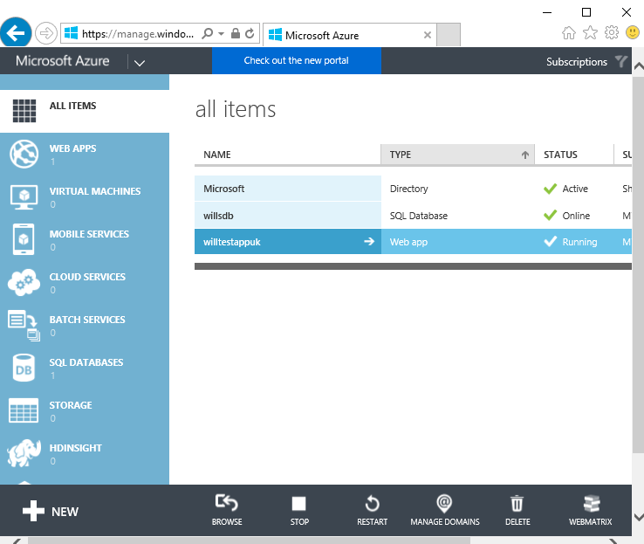
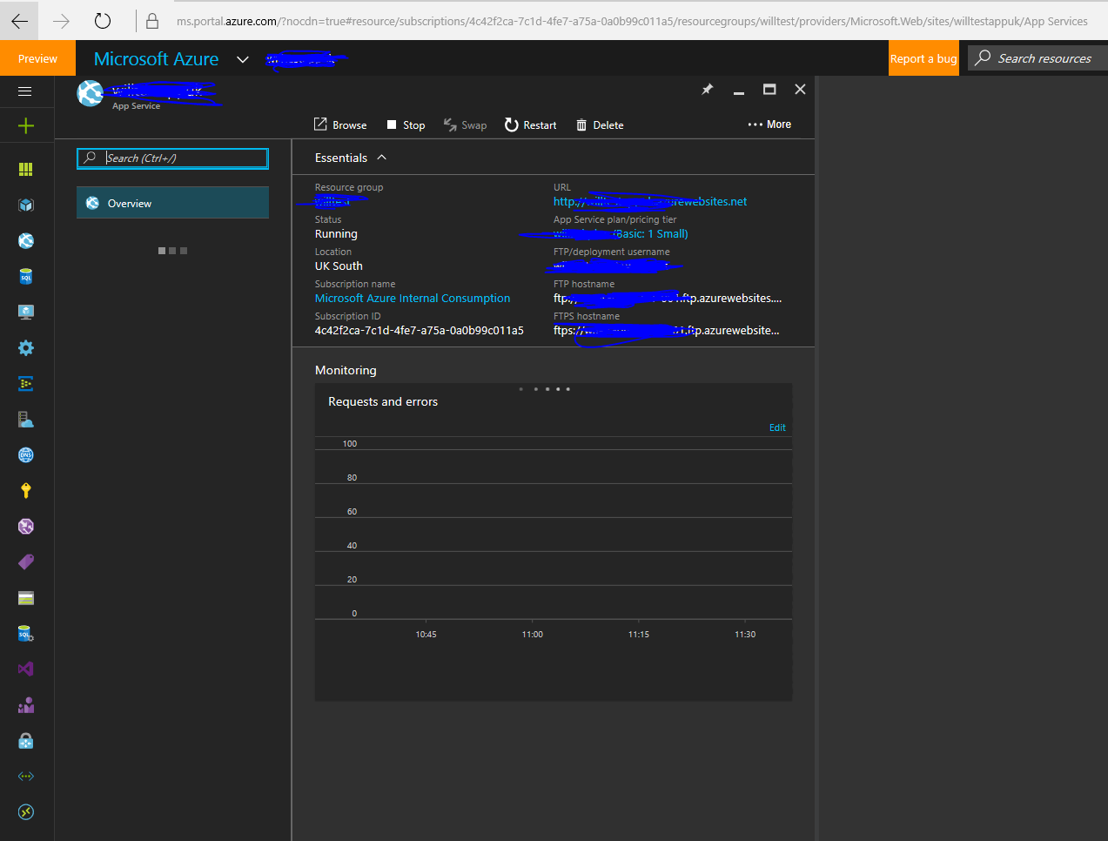
Virtual Machine Networking Options
Classic ASM
Standalone VM, configure Endpoints per VM
VM(s) on a Virtual Network, configure as a Set
Azure Resource Manager
All VMs must be on a Virtual Network, even standalone VMs

Slide 18
Network Connectivity Options
Virtual Private Network Gateway
Consider On-Premise Device regarding Static and Dynamic vs High-Performance VPN gateways
Not all devices can support multiple IPSec tunnels
Expose an SSL Endpoint
(and unlock it via your Network Security Group)
ExpressRoute Connections
VNet to VNet Peering
Hybrid Connection Options
TCP Bridge / Service Bus Based
A.K.A. BizTalk Hybrid Connections,
Service Bus Relay
Notes:
Comment on Cisco ASA Static only

Slide 19
IaaS Networking – Things to remember
Network Security Groups
Use Network Security Groups to lock down your (multiple) subnets internally and externally.
Multicast traffic is not supported.
Ask yourself - can I just expose an SSL secured endpoint ?
VPN / ExpressRoute connections will expose EVERYTHING by default behind the gateway to your internal network.
Do you want to lock them down with an NSG?
ExpressRoute connections have significantly lower connection latency than VPN
VPN Transit routing is only supported in some circumstances.
VNet peering can be used to connect VNets together without a VPN gateway.
Consider Gateway / WAF appliances such as a Barracuda, F5 or Application Gateway

Slide 20
Show and Tell: VNet Peering
Notes:
IOMeter demo
A1 vs DSv13 v G3 IOPS 4k Random

Slide 21
“Now life is simple to deploy and build resources and connect them together. But which resources do I deploy?”
Azure Virtual Machines
Implementation Team
@WillEastbury
Notes:
The theme for the afternoon will be.

Slide 22
Performance Choices - VM Choosing the right Virtual Machine and Storage Combination

Slide 23
A Series
HDD backed temporary drive
HDD backed boot volume
BSC|STD
Comes in 2 flavours; Basic and Standard
$$$
Cost effective commodity compute
MIN: 1 core and 3.5GB RAM
MAX: 20 cores and 140GB RAM

Slide 24
A Series - InfiniBand
SSD
HDD backed temporary drive
HDD backed boot volume
RDMA 40Gb/sec network configuration
Tuned for Message Passing Interface (MPI) applications
Intel® Xeon® E5 processors
MIN: 8 core and 56GB RAM
MAX: 16 cores and 112GB RAM

Slide 25
D Series
SSD
SSD backed temporary drive
HDD backed boot volume
D11:D14
Ideal for memory-intensive enterprise applications
MIN: 1 core and 3.5GB RAM
MAX: 20 cores and 140GB RAM

Slide 26
DS Series
SSD
SSD backed temporary drive
BOOT
SSD backed boot volume
SSD
D11:D14
Ideal for memory-intensive enterprise high IOPS applications
MIN: 1 core and 3.5GB RAM
MAX: 20 cores and 140GB RAM

Slide 27
Dv2 Series
SSD
SSD backed temporary drive
HDD backed boot volume
Haswell CPU core
E5-2673 v3 @ 2.4 – 3.1 GHz
i
H
~60% faster than A Series
MIN: 1 core and 3.5GB RAM
MAX: 20 cores and 140GB RAM

Slide 28
DSv2 Series
SSD
SSD
SSD backed temporary drive
BOOT
SSD backed boot volume
SSD
Haswell CPU core
E5-2673 v3 @ 2.4 – 3.1 GHz
i
H
~60% faster than A Series
MIN: 1 core and 3.5GB RAM
MAX: 20 cores and 140GB RAM

Slide 29
F Series
SSD
SSD backed temporary drive
HDD backed boot volume
Haswell CPU core
E5-2673 v3 @ 2.4 – 3.1 GHz
$$$
Lower per-hour price
H
MIN: 1 core and 2GB RAM
MAX: 16 cores and 32GB RAM
2GB RAM and 16GB local SSD per core
Ideal for CPU intensive, but memory light apps with light IO requirements
i
Notes:
Lower per-hour price, based on the 2.4 GHz Intel Xeon®

Slide 30
FS Series
SSD
SSD backed temporary drive
BOOT
SSD backed boot volume
SSD
Haswell CPU core
E5-2673 v3 @ 2.4 – 3.1 GHz
H
MIN: 1 core and 2GB RAM
MAX: 16 cores and 32GB RAM
2GB RAM and 16GB local SSD per core
Ideal for CPU intensive, but memory light apps with heavy IO requirements
i

Slide 31
N Series
SSD
SSD backed temporary drive
NVIDIA Tesla GPU Enabled with NVIDIA GRID 2.0 Technology
Low latency, (RDMA) high-throughput network interface optimized VM configuration (NC24r) which is tuned for tightly coupled parallel computing workloads.
Notes:
NVIDIA Tesla accelerated platform as well as NVIDIA GRID 2.0 technology

Slide 32
G Series
SSD
SSD backed temporary drive
HDD backed boot drive
Intel® Xeon® E5 v3 processors
MIN: 2 core and 28GB RAM
MAX: 32 cores and 448GB RAM
Notes:
Support large database workloads, specifically SAP, HANA, SQL Server, Hadoop, DataZen, and Hortonworks.
A G5 instance is isolated to hardware dedicated to a single customer.

Slide 33
GS Series
SSD
SSD backed temporary drive
BOOT
SSD backed boot volume
SSD
MIN: 2 core and 28GB RAM
MAX: 32 cores and 448GB RAM

Slide 34
What compute scenarios might you face?
Cheap, cost effective compute ?
High # of CPU Cores ?
High CPU Clock Speed per core ?
High Network Cluster Bandwidth – maybe InfiniBand ?
High Memory Allocation ?
Stupidly High Memory Allocation (400GB>) ?
Fast SSD Scratch temporary storage ?
Extreme number of Local IOPS ?

Slide 35
So, lets compare them all side by side
CPU core = Memory
A0 – A7
D1v2 – D5v2
D1 – D4
CPU core > Memory
F1, F2, F4,F8, F16
CPU core < Memory
D11v2 -D15v2
D11 - D14
G
GPU
N
CPU core++
A8-A11
G5, GS5
D15v2, DS15v2
Memory++
G4,G5,GS4,GS5
D15v2, DS15v2
Networking++
A8-A9
N
All VM sizes except the A-series have a temporary SSD scratch disk, A-series has an HDD backed scratch drive..

Slide 36
Cheap, cost effective compute ?
CPU core = Memory
A0 – A7
D1v2 – D5v2
D1 – D4
CPU core > Memory
F1, F2, F4, F8, F16
CPU core < Memory
D11v2 -D15v2
D11 - D14
G
Cheap, cost effective compute ?
GPU
N
CPU core++
A8-A11
G5, GS5
D15v2, DS15v2
Memory++
G4,G5,GS4,GS5
D15v2, DS15v2
Networking++
A10-A11
N

Slide 37
High CPU Capability (Large number of parallel cores)
CPU core = Memory
A0 – A7
D1v2 – D5v2
D1 – D4
CPU core > Memory
F1, F2, F4, F8, F16
CPU core < Memory
D11v2 -D15v2
D11 - D14
G
GPU
N
CPU core++
A8-A11
G5, GS5
D15v2, DS15v2
Memory++
G4,G5,GS4,GS5
D15v2, DS15v2
Networking++
A10-A11
N

Slide 38
High CPU Clock Speed per core
CPU core = Memory
A0 – A7
D1v2 – D5v2
D1 – D4
CPU core > Memory
F1, F2, F4, F8, F16
CPU core < Memory
D11v2 -D15v2
D11 - D14
G
GPU
N
CPU core++
A8-A11
G5, GS5
D15v2, DS15v2
Memory++
G4,G5,GS4,GS5
D15v2, DS15v2
Networking++
A10-A11
N

Slide 39
High Network Cluster Bandwidth – maybe InfiniBand?
CPU core = Memory
A0 – A7
D1v2 – D5v2
D1 – D4
CPU core > Memory
F1, F2, F4,F8, F16
CPU core < Memory
D11v2 -D15v2
D11 - D14
G
GPU
N
CPU core++
A8-A11
G5, GS5
D15v2, DS15v2
Memory++
G4,G5,GS4,GS5
D15v2, DS15v2
Networking++
A10-A11
N

Slide 40
Extreme Memory Allocation
CPU core = Memory
A0 – A7
D1v2 – D5v2
D1 – D4
CPU core > Memory
F1, F2, F4,F8, F16
CPU core < Memory
D11v2 -D15v2
D11 - D14
G
GPU
N
CPU core++
A8-A11
G5, GS5
D15v2, DS15v2
Memory++
G4,G5,GS4,GS5
D15v2, DS15v2
Networking++
A10-A11
N

Slide 41
Fast Local Temporary Storage only
CPU core = Memory
A0 – A7
D1v2
D1 – D4
CPU core > Memory
F1, F2, F4,F8, F16
CPU core < Memory
D11v2
D11 - D14
G
GPU
N
CPU core++
A8-A11
G5
D15v2
Memory++
G4,G5,GS4,GS5
D15v2, DS15v2
Networking++
A10-A11
N
All VM sizes except the A-series have a temporary SSD scratch disk, A-series has an HDD backed scratch drive..
Notes:
You can use the orange ones, but they will cost you more in the long run.

Slide 42
Extreme I/O Performance (High IOPS)
CPU core = Memory
A0 – A7
D1v2 – D5v2
D1 – D4
CPU core > Memory
F1, F2, F4,F8, F16
CPU core < Memory
DS15v2
G
GPU
N
CPU core++
A8-A11
GS5
DS15v2
Memory++
GS4,GS5
DS15v2
Networking++
A10-A11
N
All VM sizes except the A-series have a temporary SSD scratch disk, A-series has an HDD backed scratch drive..

Slide 43
GPU Clusters, Remote FX workstation
CPU core = Memory
A0 – A7
D1v2 – D5v2
D1 – D4
CPU core > Memory
F1, F2, F4,F8, F16
CPU core < Memory
D11v2 -D15v2
D11 - D14
G
GPU
N
CPU core++
A8-A11
G5, GS5
D15v2, DS15v2
Memory++
G4,G5,GS4,GS5
D15v2, DS15v2
Networking++
A10-A11
N

Slide 44
In summary, your VM ready reckoner
Cheap, cost effective compute
A Series (BASIC/STD), Dv2 Series
High number of CPU cores
G Series
High CPU Clock Speed
Dv2, G, F Series
High network cluster bandwidth
A8, A9 Series, N Series
High memory allocation
G Series
SSD temporary storage
D, F, G Series
High local IOPS
DSv2, FS, GS

Slide 45
“Now life is simple to deploy and build the right resources and connect them together. How can you make those resources perform ?”
UK Developer Experience Team
@WillEastbury
Notes:
The theme for the afternoon will be.

Slide 46
Performance Gotchas Storage Throttling

Slide 47
Be aware of the Azure Storage Service Throttles
Bandwidth – max 60MB per VHD
IOPS: Basic A-Series VM – 300 per VHD
IOPS: Standard A-Series, D Series, G Series, F Series VM – 500 per VHD
IOPS: DS Series, GS Series, FS Series VM – Depends on Premium Tier
IOPS: Limit Per-Standard Storage Account - 20,000
Max VHDs per Storage Account: 20,000/500 = 40
Hence limit is 40 standard vhds

Slide 48
So what should we do?
Set up a throttling alert in the portal !
Use Windows Storage Spaces to Stripe Data
Premium Storage for guaranteed IOPS per VM

Slide 49
Demo 2: Storage Performance Characteristics
Notes:
IOMeter demo
A1 vs DSv13 v G3 IOPS 4k Random

Slide 50
Show and Tell: Setup a Throttling Alert
Notes:
IOMeter demo
A1 vs DSv13 v G3 IOPS 4k Random

Slide 51
“So, now I can deploy my resources and make them perform. How do I scale IaaS resources out in a set to make them elastic ?
You ☺
@WillEastbury
Notes:
The theme for the afternoon will be.

Slide 52
Scaling Options Scale up or Scale Out, the choice is yours.
Notes:
Load Balancers
VM Scale Sets
Show possible deployment of Epic VM Scale Set Service “Scales Like PaaS, Manage like IaaS”
Demo

Slide 53
Demo 3: Deploying a VM Scale Set from Visual Studio
Notes:
Build and Deploy a VM Scale SET IN an ARM template project

Slide 54
 MSIaaS1011
@WillEastbury

